Slide 1


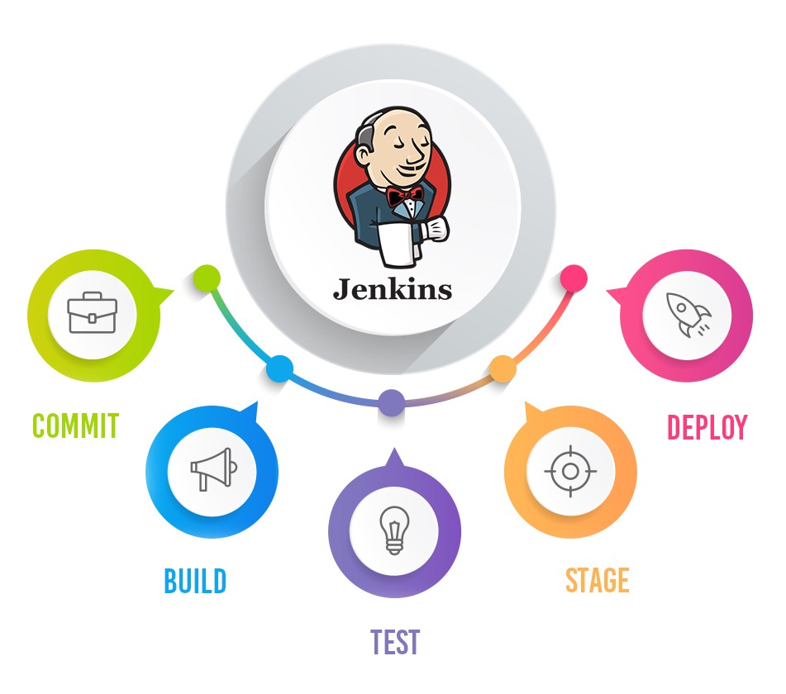
Jenkins Mastery for Software Tester
Pramod Dutta
Top 19 Plugins to Add as QA on Jenkins

Slide 2
Agenda
Let’s discuss about the Important Jenkins Plugins

Slide 3
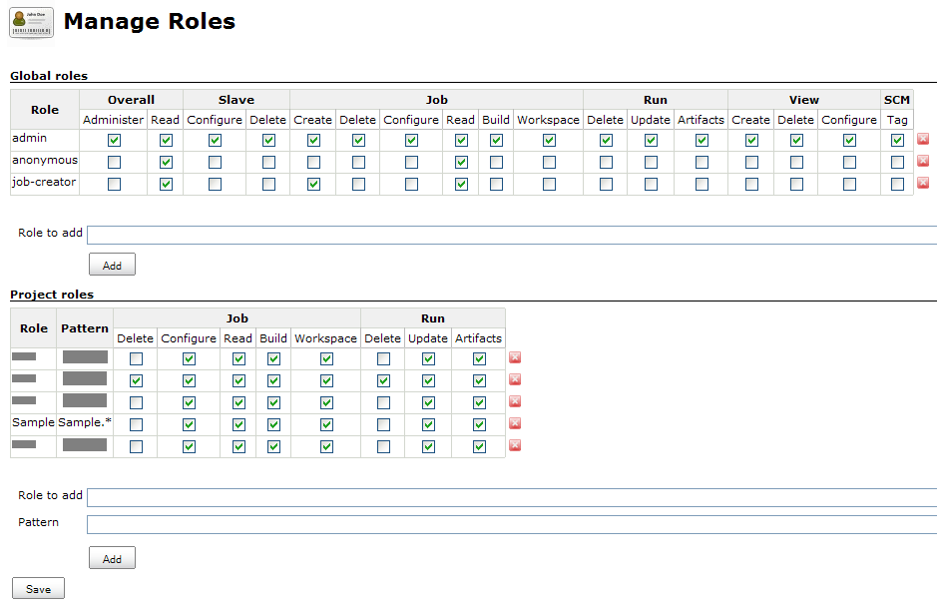
Role-based Authorization Strategy
https://plugins.jenkins.io/role-strategy/

Slide 4
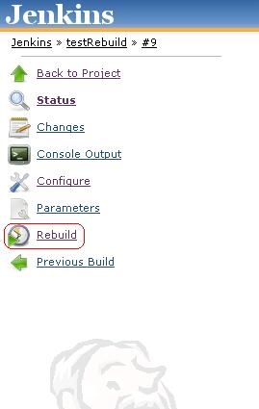
Rebuilder Plugin
https://plugins.jenkins.io/rebuild/

Slide 5
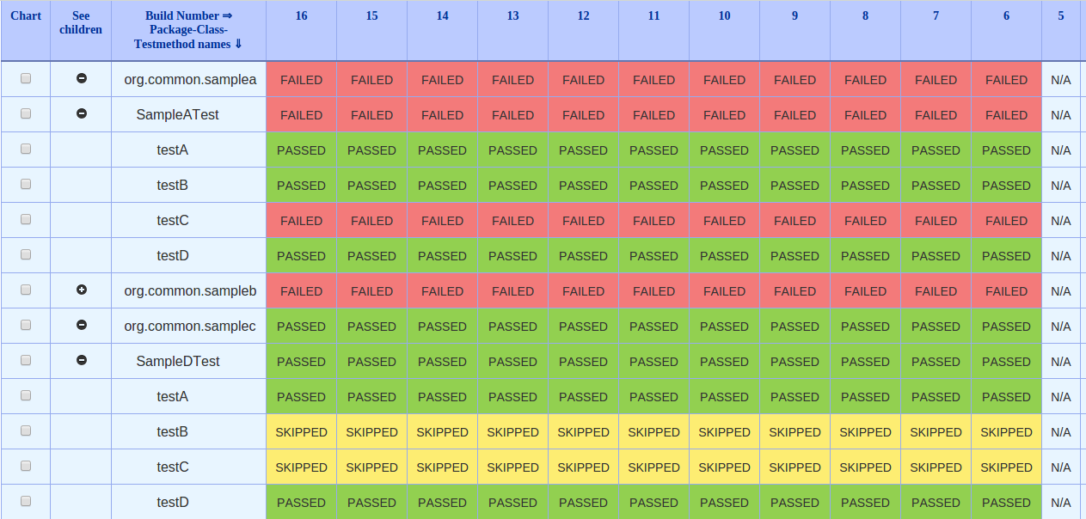
Test Results Analyzer
https://plugins.jenkins.io/test-results-analyzer/

Slide 6
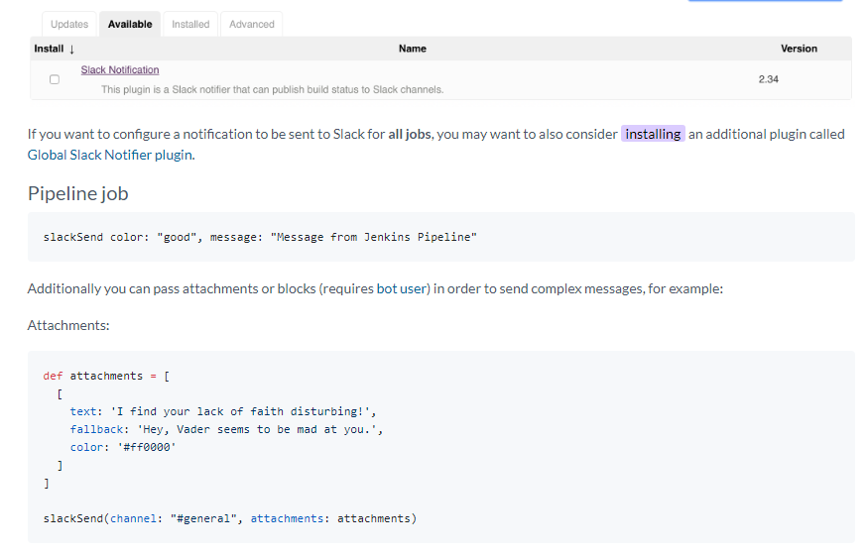
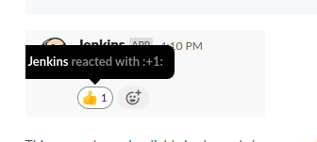
Slack Notification
https://plugins.jenkins.io/slack/

Slide 7
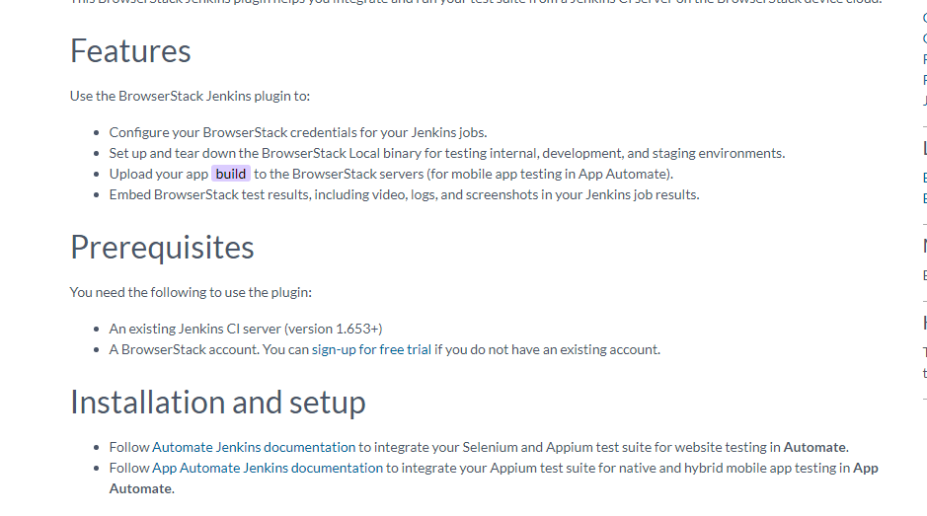
BrowserStack
https://plugins.jenkins.io/browserstack-integration/

Slide 8
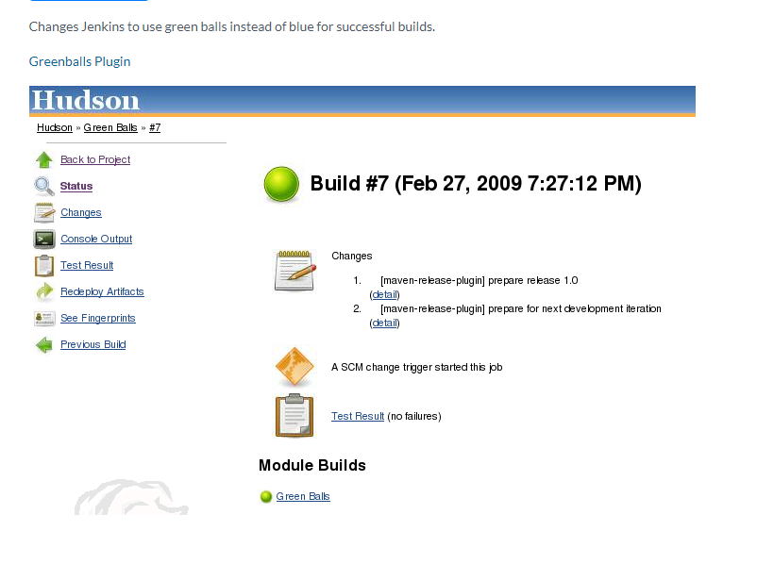
Green Balls
https://plugins.jenkins.io/greenballs/

Slide 9
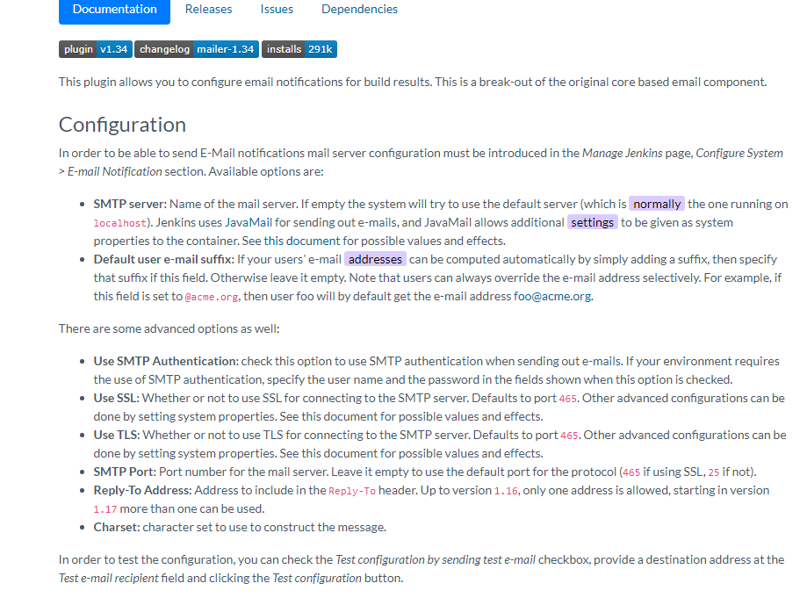
Mailer
https://plugins.jenkins.io/mailer/

Slide 10
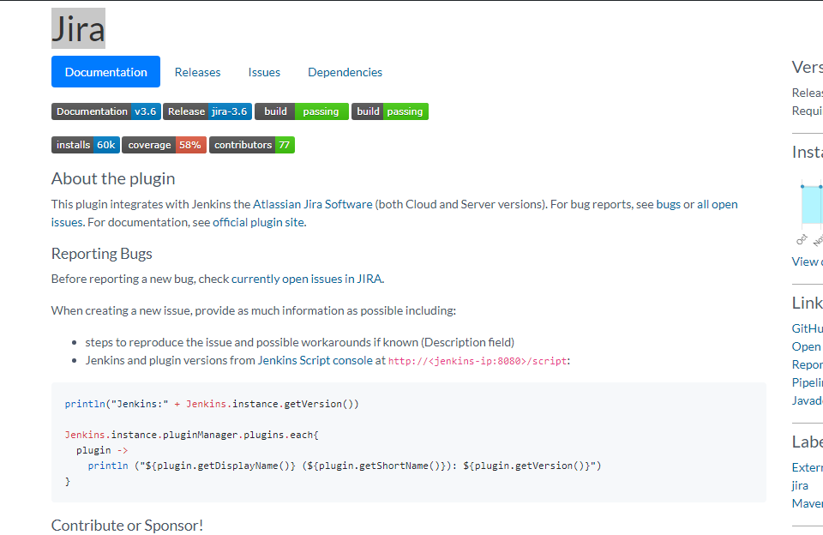
Jira
https://plugins.jenkins.io/jira/

Slide 11
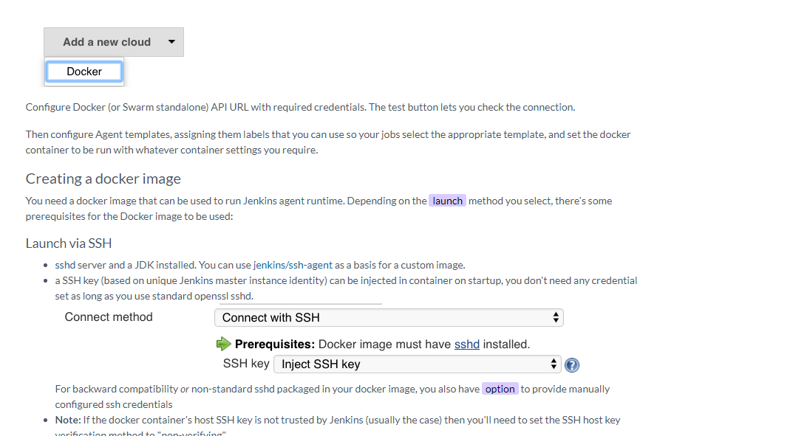
Docker plugin for Jenkins
https://plugins.jenkins.io/docker-plugin/

Slide 12
BONUS
https://plugins.jenkins.io/envinject/
https://plugins.jenkins.io/parameterized-trigger/
https://plugins.jenkins.io/pipeline-build-step/
https://www.jenkins.io/doc/pipeline/steps/credentials-binding/
https://plugins.jenkins.io/ec2/
https://plugins.jenkins.io/dashboard-view/
https://plugins.jenkins.io/build-pipeline-plugin/
https://plugins.jenkins.io/jenkins-multijob-plugin/
https://plugins.jenkins.io/git/
https://plugins.jenkins.io/view-job-filters/
https://plugins.jenkins.io/timestamper/

Slide 13

Lets See Jenkins Job Demo
Demo Jenkins job

